Slide 1

QUOTE GENERATOR APP USING STREAMLIT
Presented by-ARIT KAR
Intern id-MST03-0071
Guided by-urooj khan

Slide 2

INTRODUCTION
Purpose: The Quote Generator App automates the collection of quotes based on user-selected topics, making it easy to access and save inspirational content.
Motivation: With the growing popularity of quotes on social media and in personal development, this app offers a quick way to gather and organize quotes without manual searching.
Scope: The app focuses on scraping quotes from a reliable online source, allowing users to download the data in a CSV format for further use.
User Experience: Designed for simplicity and ease of use, the app provides a clean interface where users can easily select topics and retrieve quotes.

Slide 3

WHAT IS WEB SCRAPING?
Web scraping is the process of automatically extracting data from websites. It involves sending a request to a webpage, retrieving the HTML content, and then parsing that content to find specific information, such as text, images, or links. Made up of interconnected nodes (neurons)
Web scraping is commonly used to gather data for analysis, automate repetitive tasks, or collect information that is not readily available through APIs.Can solve complex image problems
Tools like BeautifulSoup and Scrapy in Python are often used for this purpose.

Slide 4
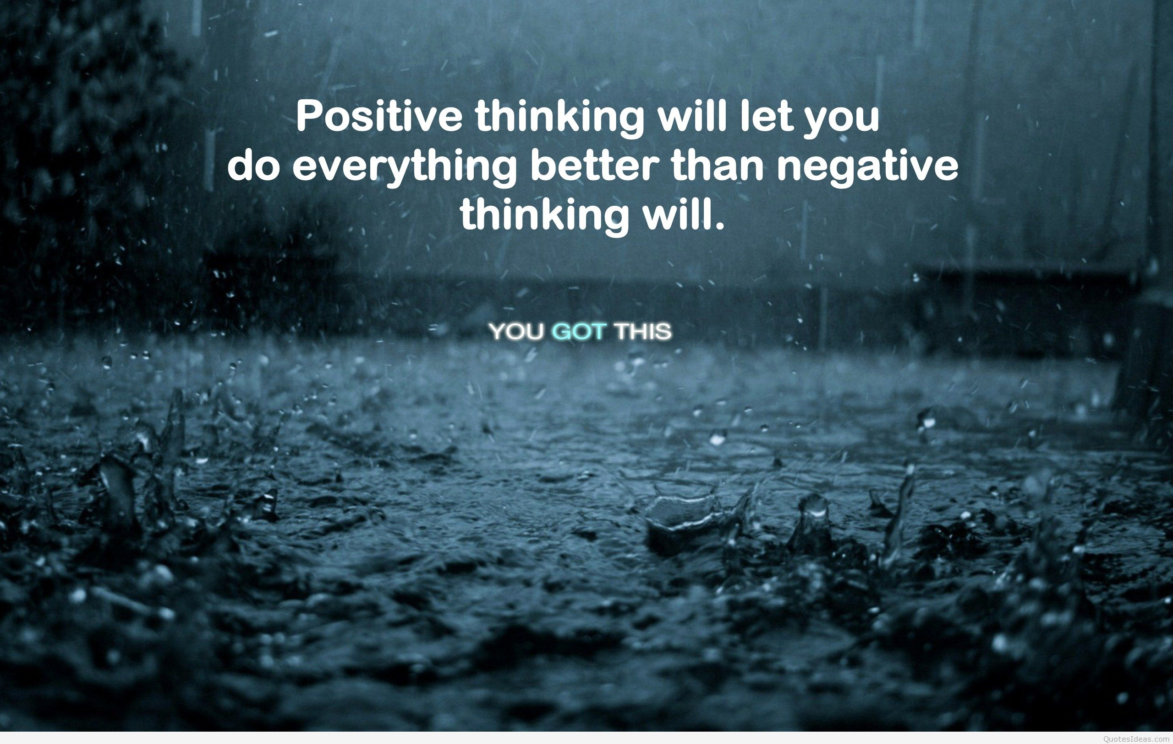
TECHNOLOGY STACK?
Python: Core programming language used for its versatility and extensive libraries.
Streamlit: Framework for building interactive web applications quickly and easily.
Requests: Library for sending HTTP requests to retrieve web pages.
BeautifulSoup: Tool for parsing HTML and extracting specific data (quotes, authors, links).
Pandas: Data manipulation library used for organizing and exporting the scraped data into CSV format.
HTML & CSS: Incorporated within Streamlit for customizing the app's layout and styling.

Slide 5

APP WORKFLOW
User Selects Topic: Users choose a quote topic from a dropdown menu in the app.
Web Scraping: The app sends a request to the target website and retrieves relevant quotes based on the selected topic.
Data Parsing: Extracts quote text, author name, and link to the author’s page using BeautifulSoup.
Display Quotes: The extracted quotes are displayed in the app with clickable author names.
CSV Generation: Users can download the displayed quotes as a CSV file by clicking the "Generate CSV" button.
Data Export: The app organizes the data into a structured CSV file with columns for Quote, Author, and Link.

Slide 6
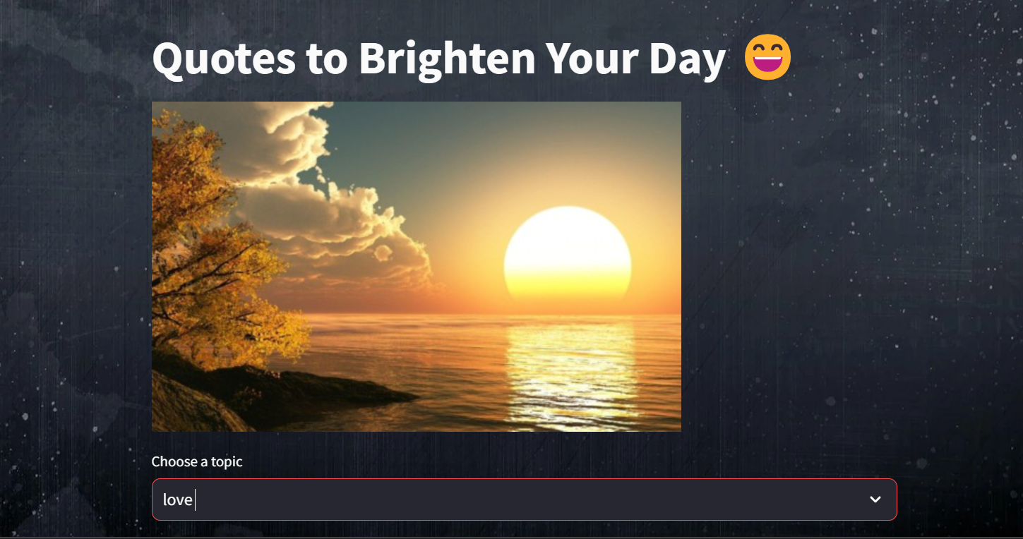
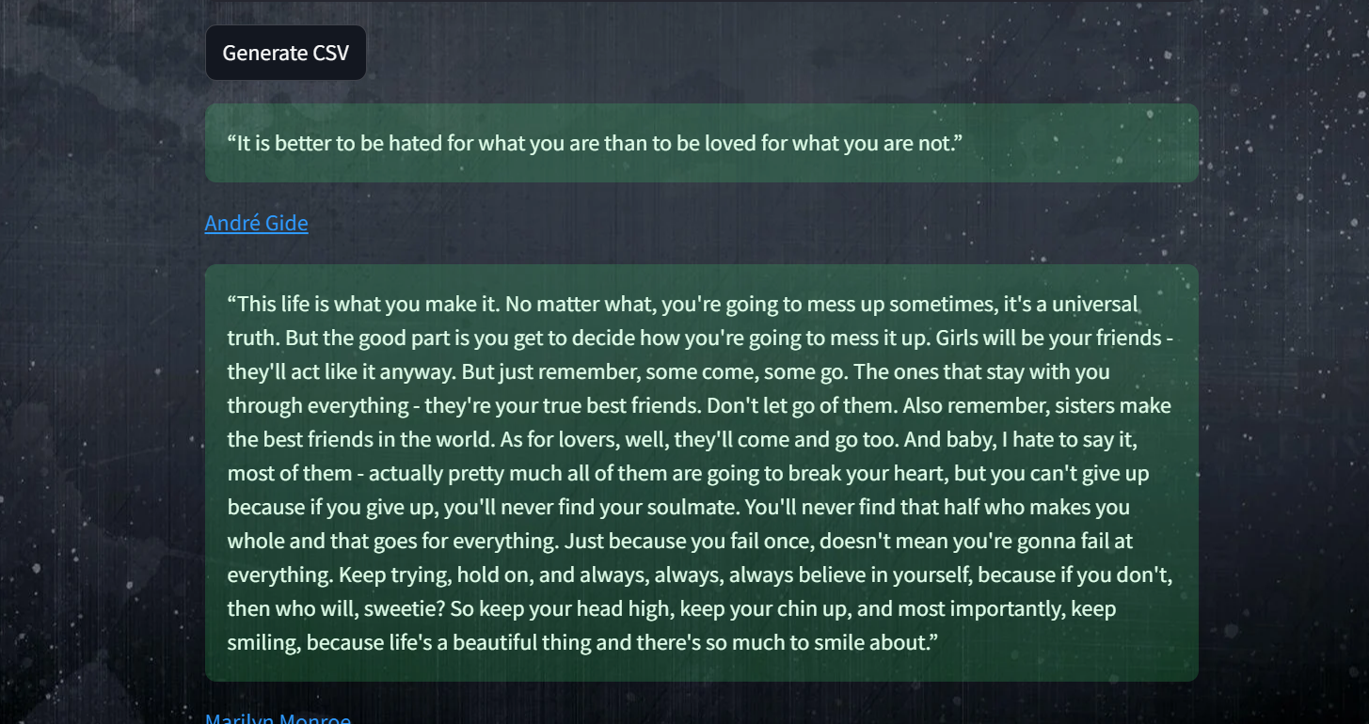
STREAMLIT INTERFACE

Slide 7
CONCLUSION
Summary: Built a Streamlit app for generating quotes based on user-selected tags.
Features: Scrapes quotes, provides CSV export with quotes, authors, and links.
Impact: Simplifies access to and sharing of inspirational quotes.
Next Steps: Consider adding more features and improving UI.

Slide 8
THANK YOU

